Slide 1

Shiny App Development for
The Health and Welfare Group
Joanne Murphy
Health and Welfare, Salmon and Freshwater Fisheries
R Users Group Day
5th October 2022
joanne.murphy@gov.scot
Notes:
Hi I am Jo Murphy and today I am going to talk about my background in R and how I developed my first Shiny apps.

Slide 2
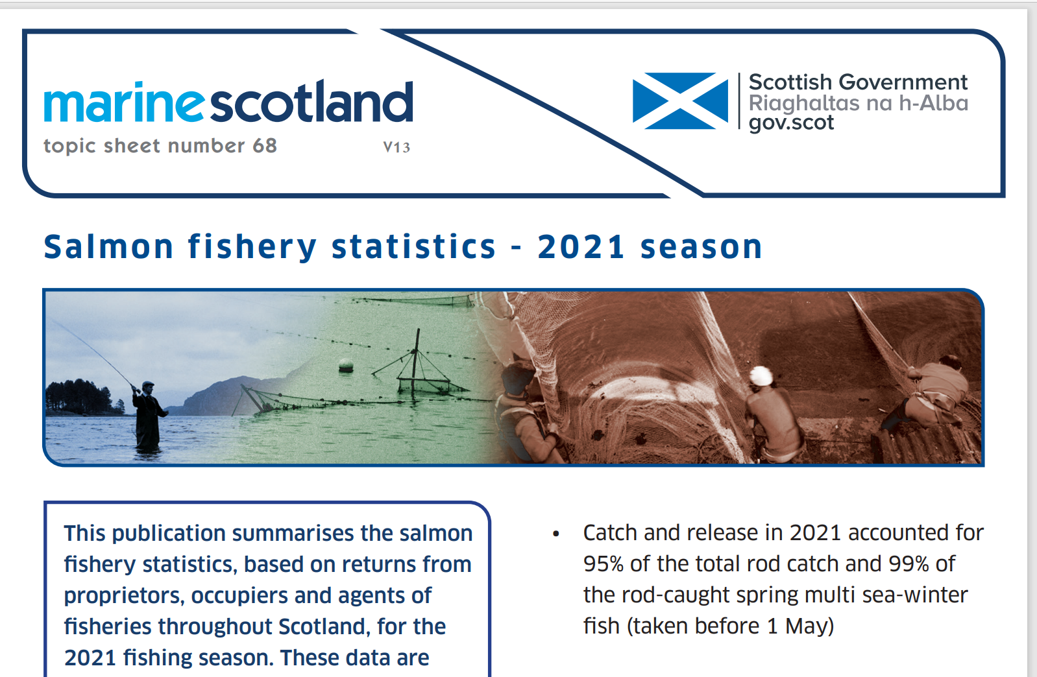
Beginning Work at Marine Scotland Science
Notes:
I joined Marine Scotland Science three and a half years ago after working for most of my career in Genetics, where I had more or less managed to avoid R.
My position was in the Assessment group in the Salmon and freshwater fisheries programme. This group collects all the data regarding wild salmon and trout rod catches across Scotland.
Half of my job was office-based - collecting the rod catch Official Statistics and admin support at the Montrose field station. The other half was in the field - sampling rivers to support wild salmon assessment and management.

Slide 3
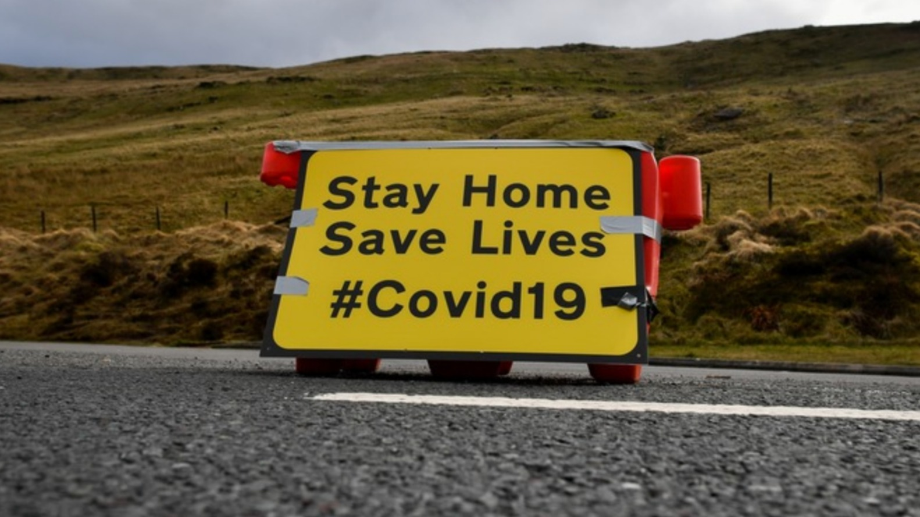
Work during COVID
Notes:
However during the pandemic my duties in the office and in the field were greatly reduced.

Slide 4
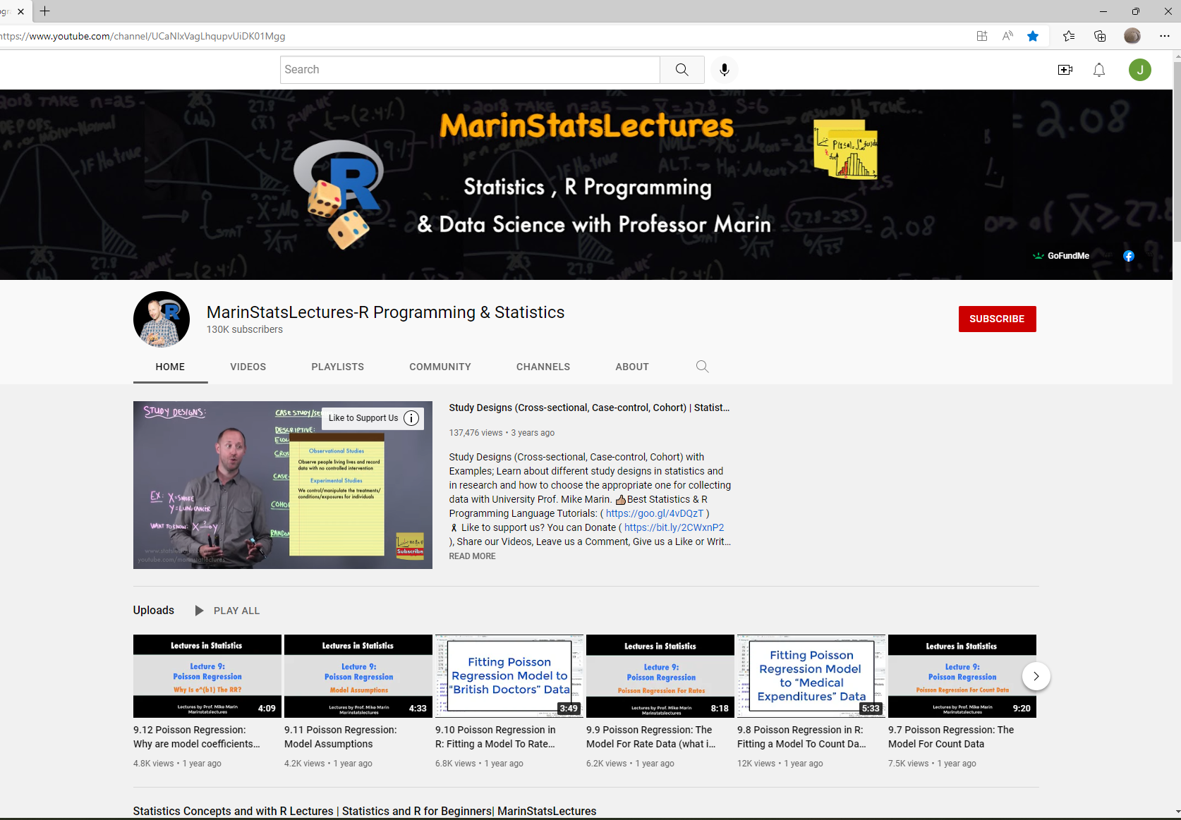
https://statslectures.com/
Notes:
I took this opportunity to refresh my stats knowledge and to learn R.
I found this series of online lectures really easy to understand with downloadable datasets. I could pick them up when work allowed and repeat them whenever I wanted.
I started to apply some of the stats to a large set of sea trout data that had not been analysed previously.
Then I changed jobs and moved to the Health and Welfare group as an Aquaculture Data scientist.

Slide 5
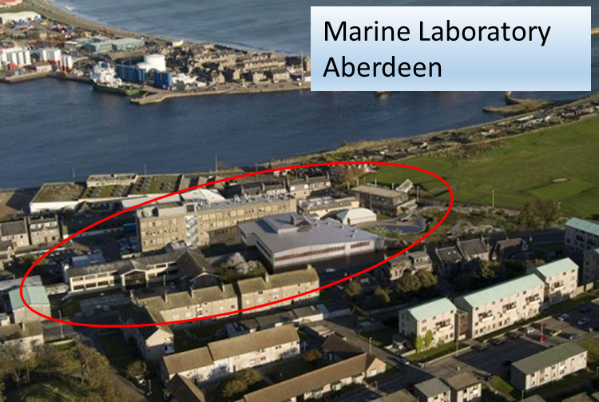
Health and Welfare Group Salmon and Freshwater Fisheries Programme
Group Lead: Sandy Murray
Small team of 5 scientists
Produces Official Statistics for Aquaculture Production in Scotland
Studies the spread of disease in fish farms and
Diseases of wild and farmed fish
Uses epidemiology to understand existing diseases and parasites
Notes:
The Health and Welfare Group is also part of the Salmon and Freshwater Fisheries Programme.
Our Group Lead is Sandy Murray and we are a small team of 5 scientists.
The Group Produces Official Statistics for Aquaculture Production in Scotland
We study the spread of disease in fish farms and the implications of wild and farmed fish interactions in terms of disease.
It uses epidemiology to understand existing infective diseases, particularly regarding the effects of sea lice.

Slide 6
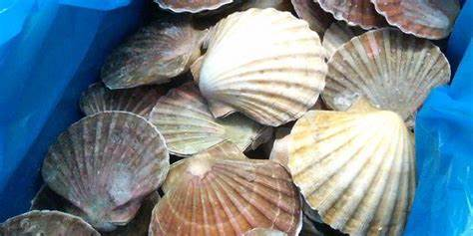
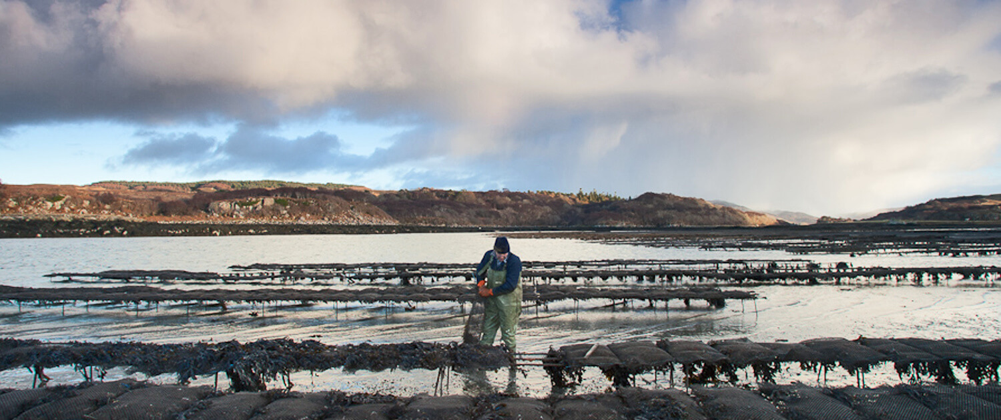
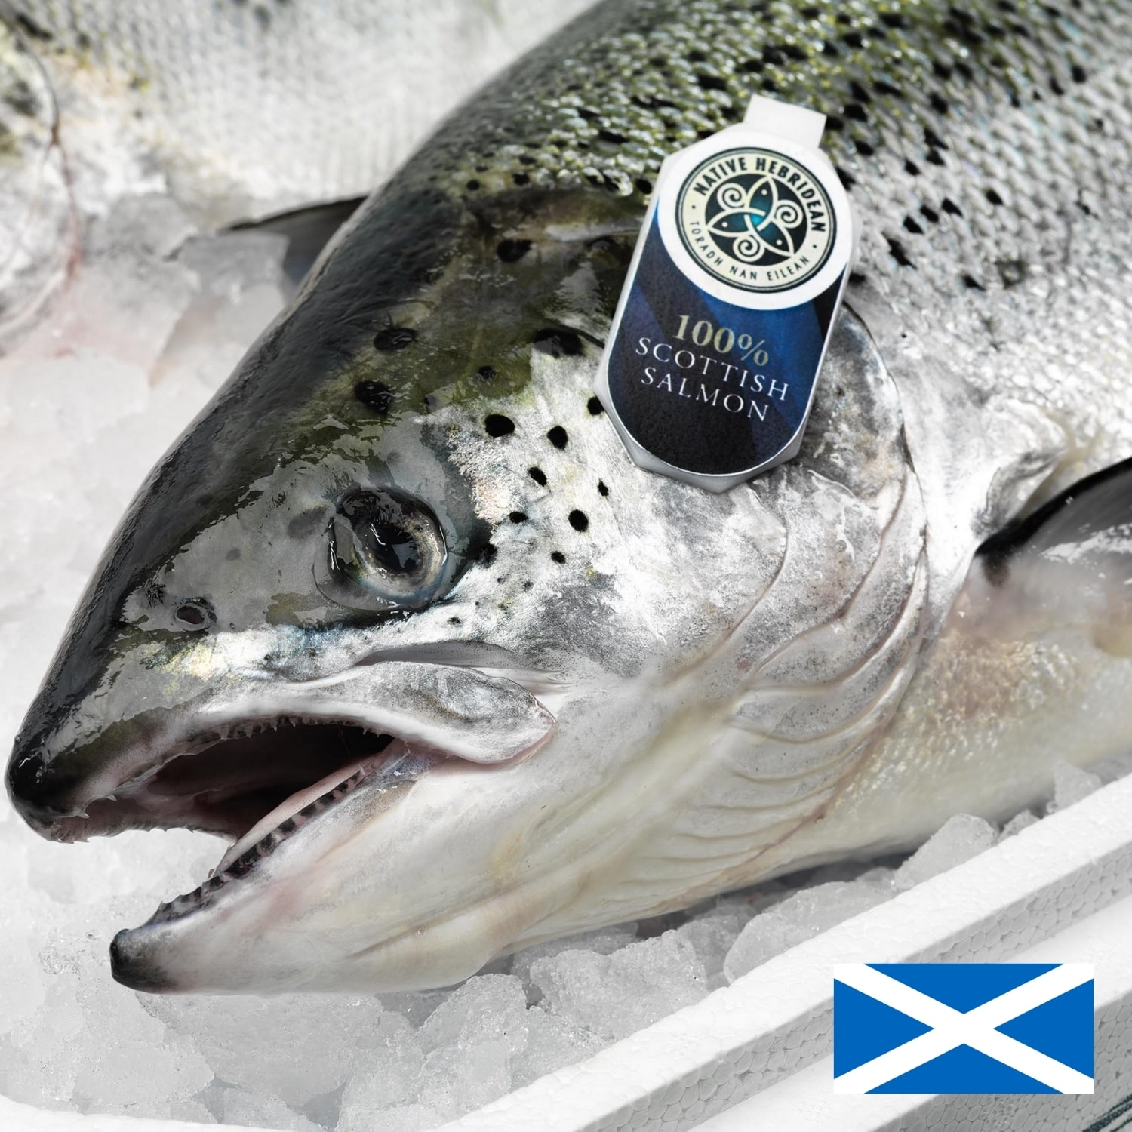
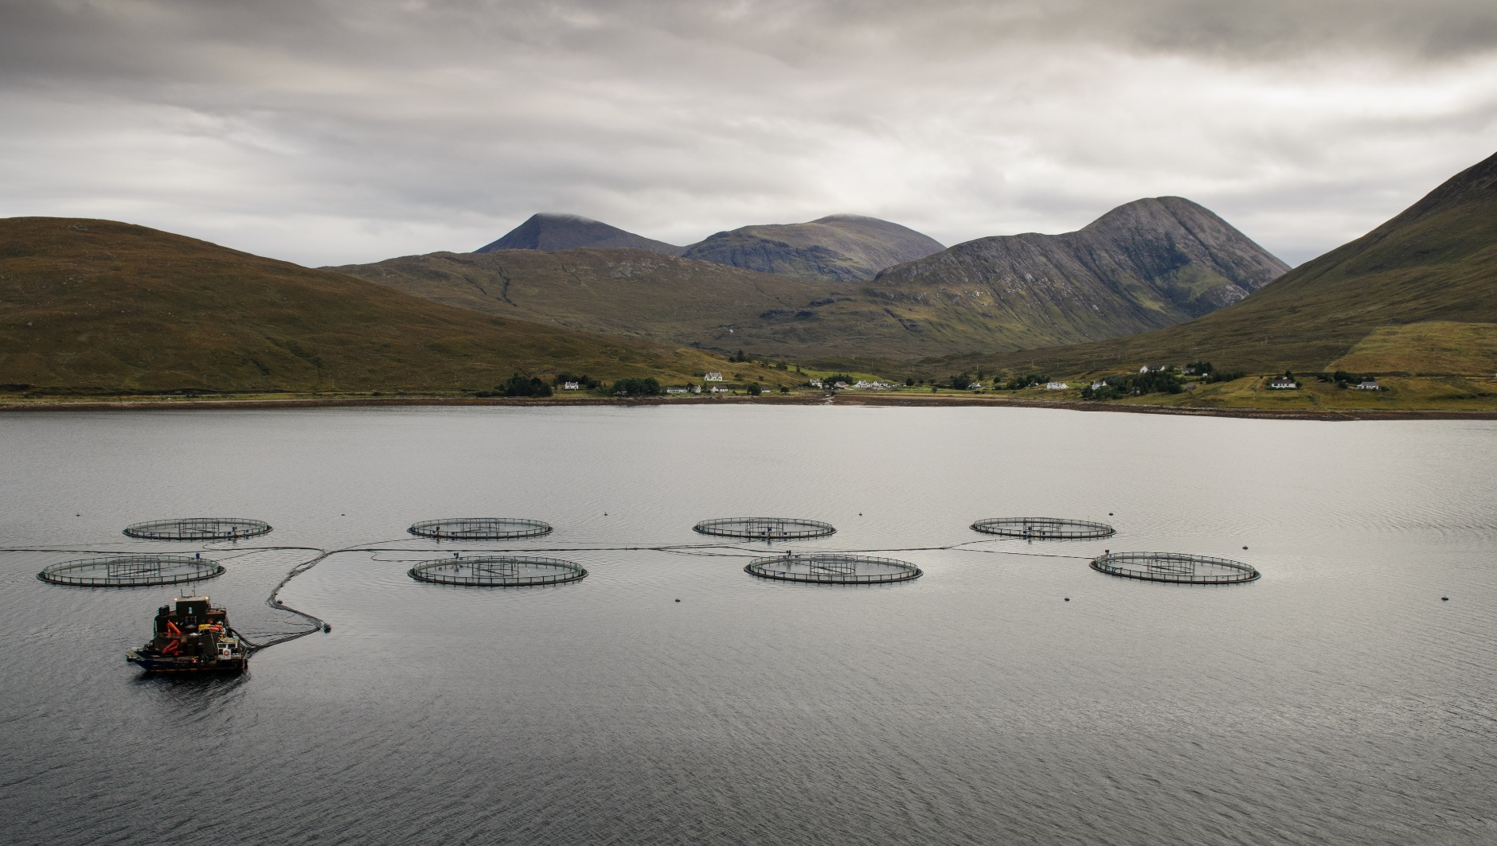
Notes:
Aquaculture is one of the largest components of Scotland’s Blue Economy and salmon are among the UK’s top food exports.
The Aquaculture Production Statistics for Scotland have been collected for over 40 years and published by the Marine Laboratory in Aberdeen.
They are a very important dataset for science, policy and industry. They form a major resource for developing Scottish Government Policy regarding many aspects of the Fish Farm industry.

Slide 7


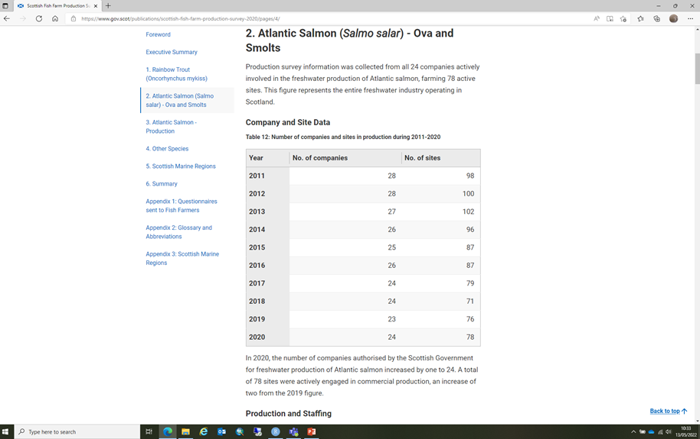


Two Annual Production Surveys: Finfish and Shellfish
Lorna Munro
Notes:
Production data is collected for finfish – predominantly salmon and trout, and shellfish – mussels, scallops and oysters. Also data about numbers of employees etc. is collected.
Lorna Munro in our group collects, analyses and publishes the 2 surveys as Official Statistics every year, following the same tabular format.

Slide 8
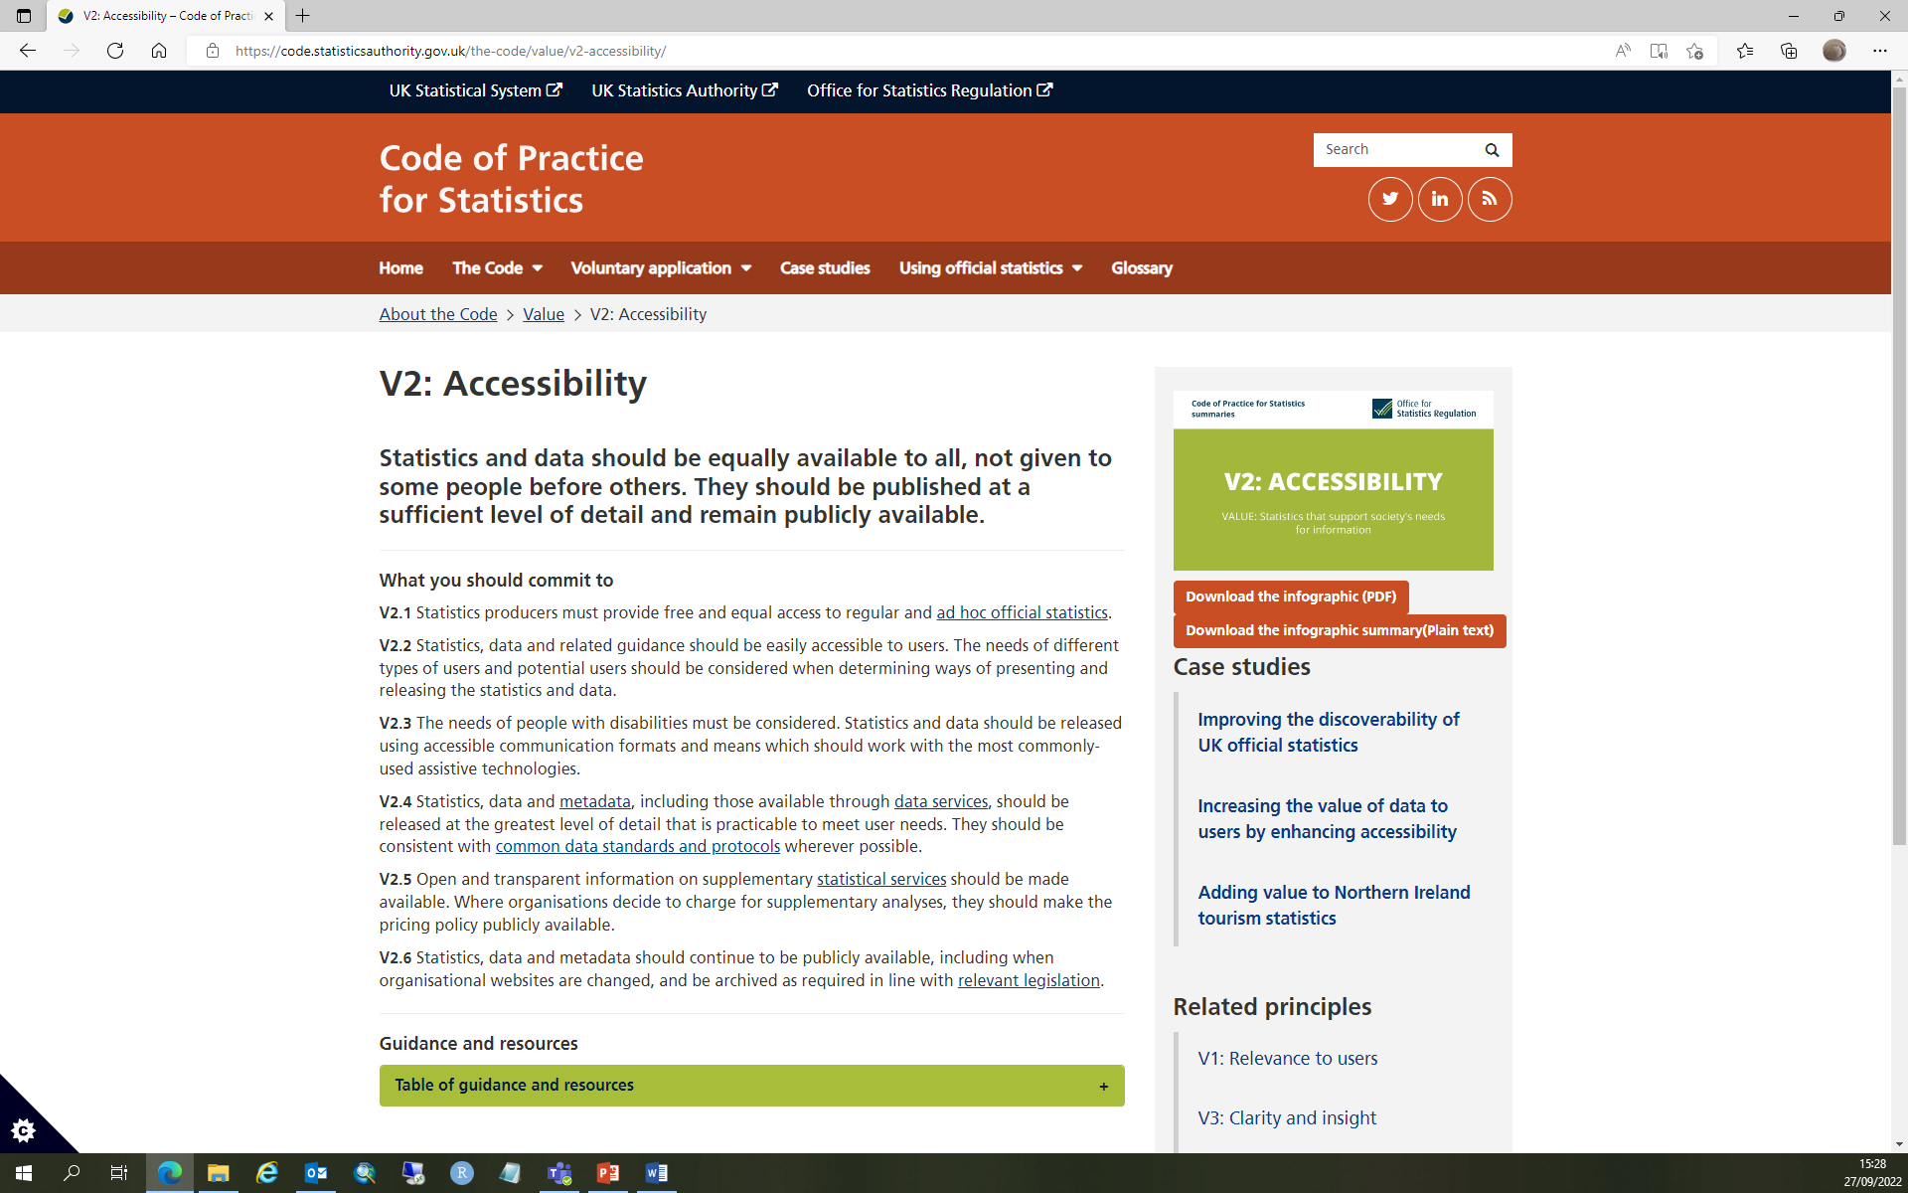
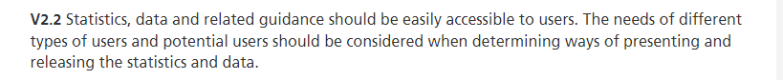
Official Statistics – Code of Practice
Notes:
We felt we needed a more accessible approach
The code of Practice for Official Stats requires that the data should be easily accessible to users, which tables of data are to some, but not all.
Spreadsheets of data are very valuable for analysis, but often Policy colleagues come to us and require quick intuitive answers to trends in Scottish aquaculture. A graphical approach can be easy to interpret when they are required to brief ministers at short notice.
- hence the Shiny App.
It was felt this would be a good project for me as a new member of the team.

Slide 9
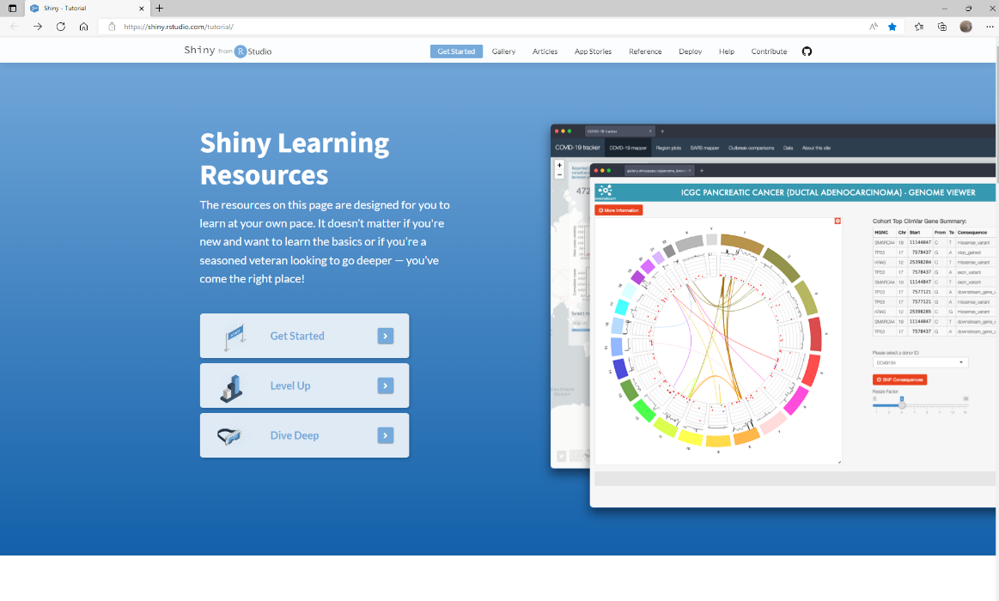

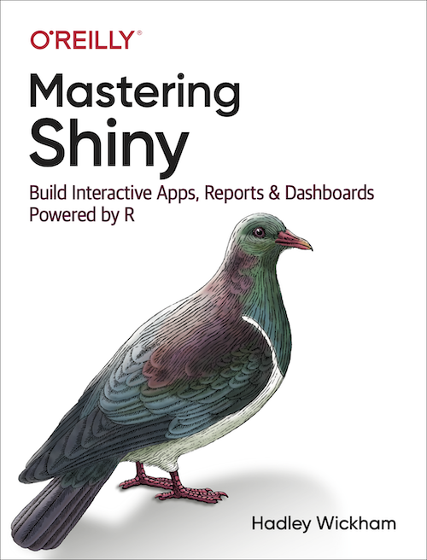
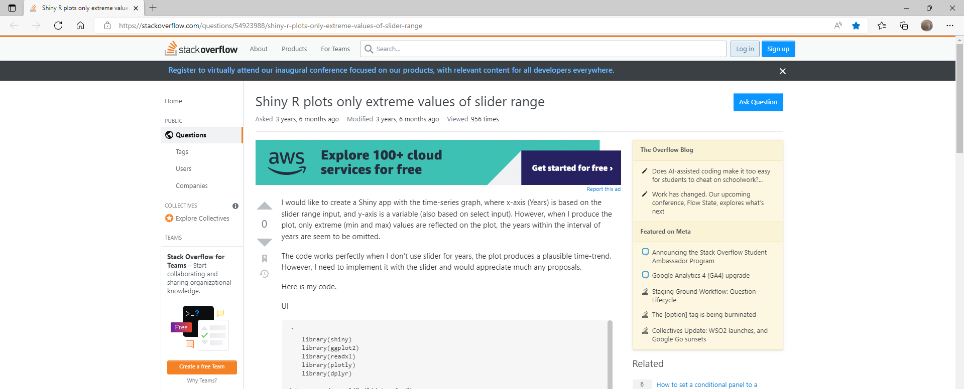
How to get started with R Shiny:
Notes:
To start, I found it helpful to contact colleagues that had already made a Shiny.
In our programme Nora Hanson was able to show me a simple shiny she had made, answer my questions and reassure me in this daunting task.
There are lots of online resources –Shiny from R Studio, this online book was a good starter. It is user-friendly with very simple code, leading you step-by-step through the process of making a Shiny.
When you get stuck the Q&A in Stack overflow are helpful. Most of the questions I had had already been answered there.
Also YouTube is a very good resource

Slide 10
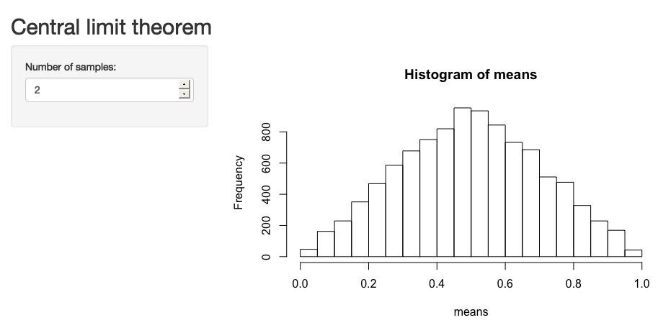
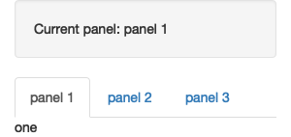
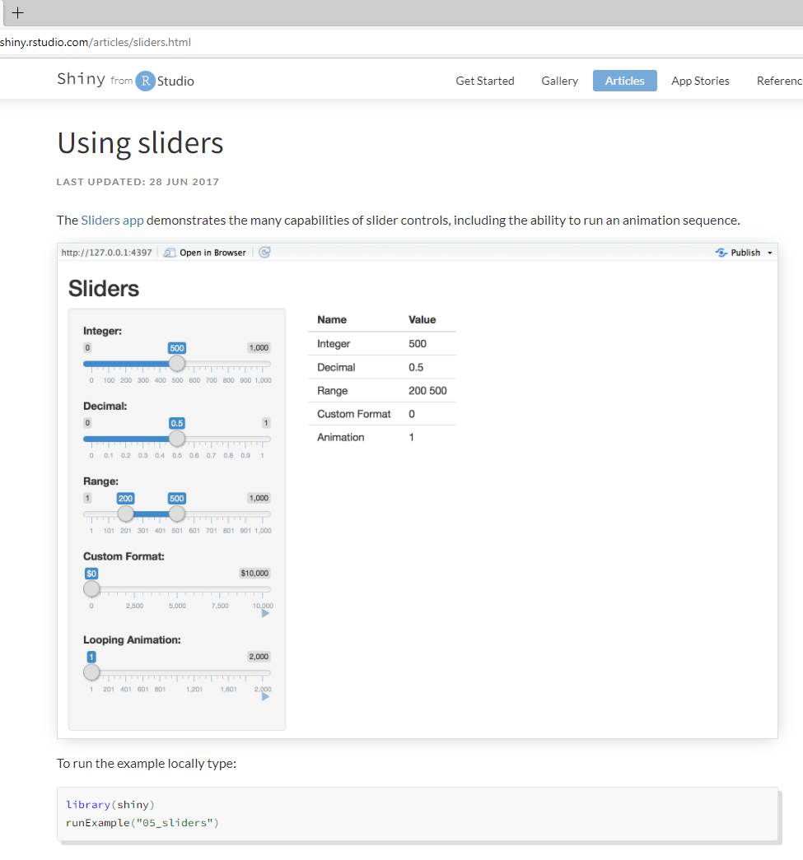
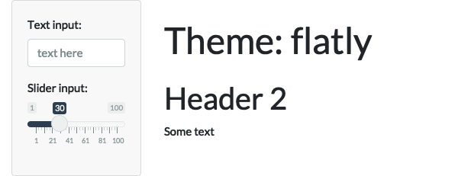
Create User Interface (UI)
Build the UI code and then the Server
- Code in 2 files: ui.R, server.R
Tabs
Dropdown menus
Sliders
Plots
Notes:
Decide what you want to have in your Shiny.
Do you want tabs dropdown menus, slider or plots
There are 2 file options in R for making a shiny: having one file containing the ui and the server code, or having two files one for the ui and another for the server. If you are building a very simple Shiny you can put everything in one file, but if it is more complicated I would choose to have the ui and sever code in separate files.
Discuss with colleagues what you want to show and who is going to be using it. Try to keep it as simple as possible.

Slide 11
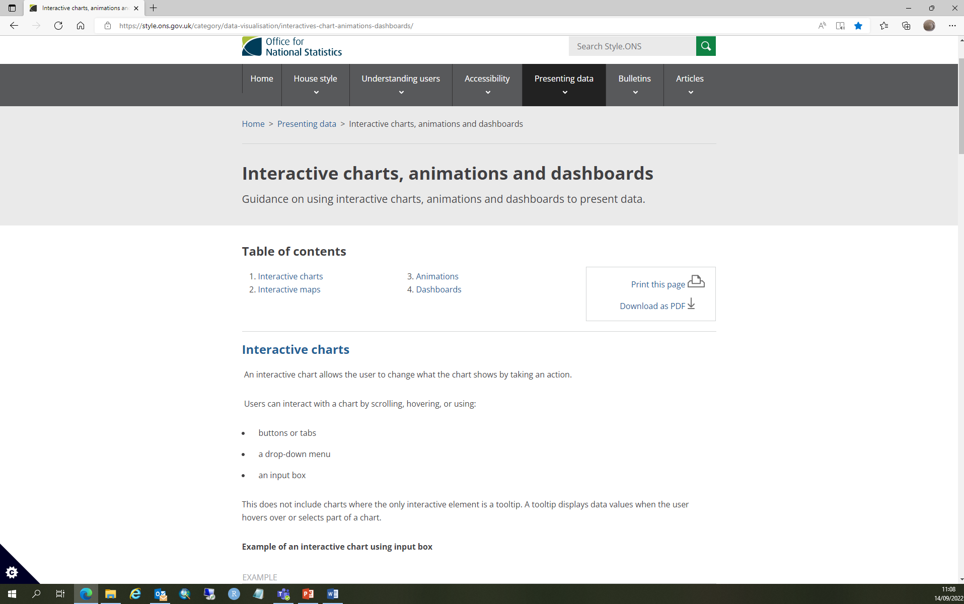
ONS Guidelines
https://style.ons.gov.uk/category/data-visualisation/interactives-chart-animations-dashboards/
Tips for creating an interactive chart
Only include data that will be important to your user.
Do not include all your data just because the interactive format allows it.
Design your chart in a way that helps the user get the most meaningful information.
Provide context and help the user to navigate the data through annotations and the surrounding text.
Notes:
It is easy to get carried away when you start looking at what is possible to create in Shinys, but this ONS website is helpful at keeping your feet on the ground and reminding you only to incorporate the amount of interactivity you really need.
Design your chart in a way that helps the user get the most meaningful information, for example, by allowing the user to easily compare certain categories.

Slide 12
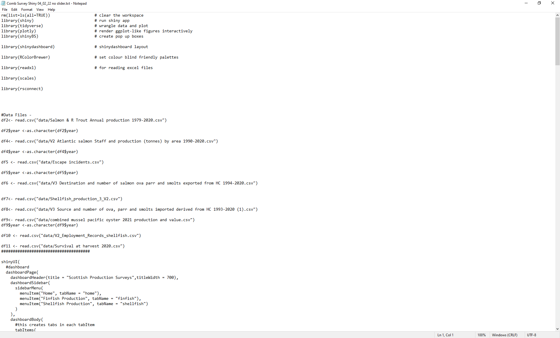
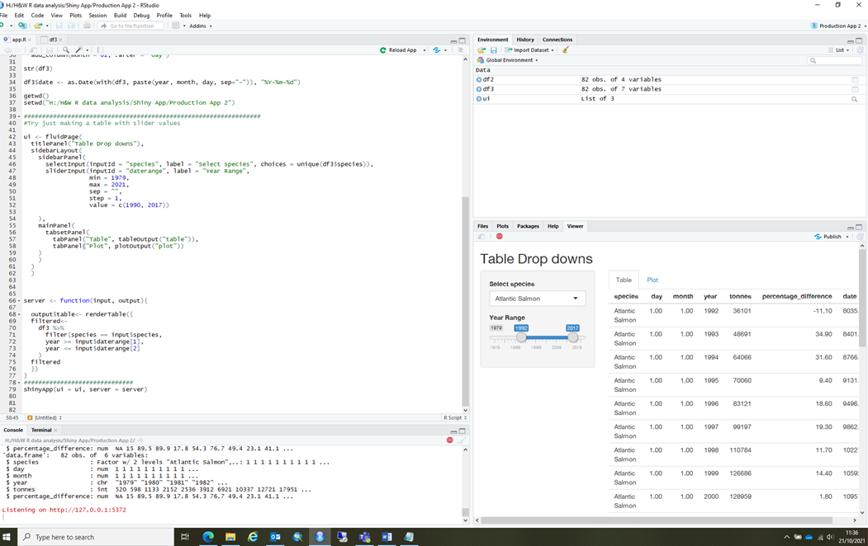
Start Simple
Step by Step, building complexity
Notepad
R Studio
Notes:
I started by making a simple Shinys first, showing my data in a table. Just to see how things worked.
I added things one at a time.
I added a dropdown for species selection, for this I had to make sure the datasets were in the correct format for the dropdowns to work. Before you make a change in your code, save the original code in notepad in case everything falls over! And you can just go back easily to a step to where everything worked.

Slide 13

Server Code
Test Plots out in R before putting them in the Shiny
Test after each change in code - copy into Notepad before making changes
Notes:
Work with the server code in the same way as for the UI, go step by step. Everything can fall over with a comma missing or a bracket in the wrong place.
It is a good idea to test that your plots work in R before adding the code to the shiny.

Slide 14
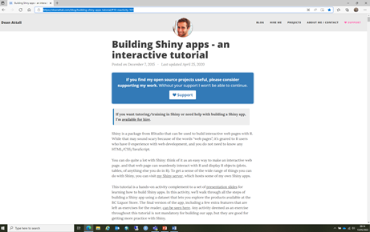
Reactivity: Making Plots change with UI Changes
Building Shiny apps - an interactive tutorial (deanattali.com)
If you want your plot to change when you change your dropdown or slider you need to incorporate reactivity.
As an extreme oversimplification, it means that when the value of a variable x changes, then anything that relies on x gets re-evaluated.
Notes:
Reactivity is what enables your outputs to react to changes in inputs.
It changes the plots when the UI dropdowns and sliders are changed.
I found this difficult to code at first, but this website was very helpful
It has a good explanation of reactivity and how it works.

Slide 15
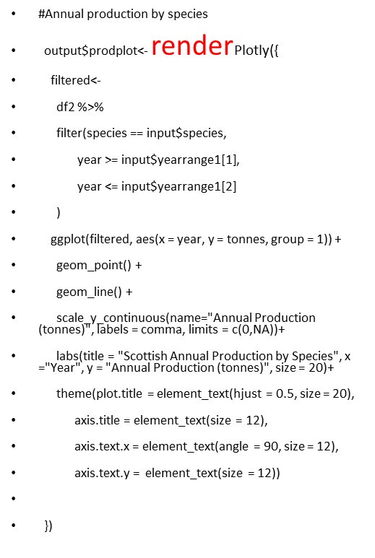
Reactivity Code in the Server.R
How to make your dropdowns and sliders change your plot
Put the reactive variables: input$species, Input$yearrange1[1]
Input$yearrange2[2] inside a function (e.g. filtered).
Use filtered as the data argument in the ggplot code.
Put everything inside a Reactive function such as renderPlotly({})
Notes:
To link the plot output to the dropdowns and Sliders you need to use a reactive expression such as render and put the slider outputs into a function used by ggplot.
Here you can see the dropdown menus and slider year range code inside a variable called “filtered”. This is what is used as the data argument in the ggplot. All this is put inside the renderPlotly reactive function.

Slide 16
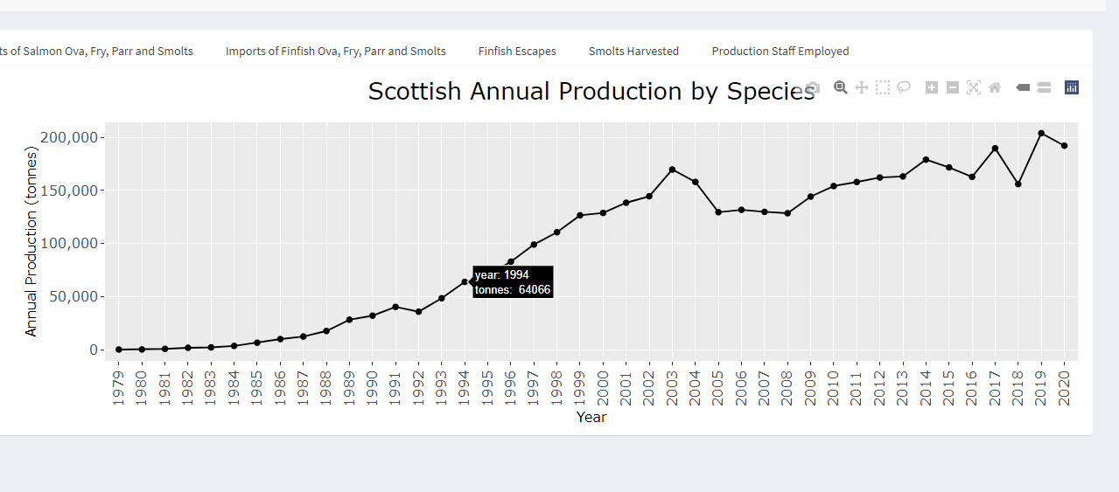
Use Plotly not Plot
If you plots are reactive
If you want to see the values in the plot when you hover over points
Notes:
Plotly works better with reactive outputs than Plot.
I wanted the plot to show the data when you hover over points – Plotly does this too.

Slide 17
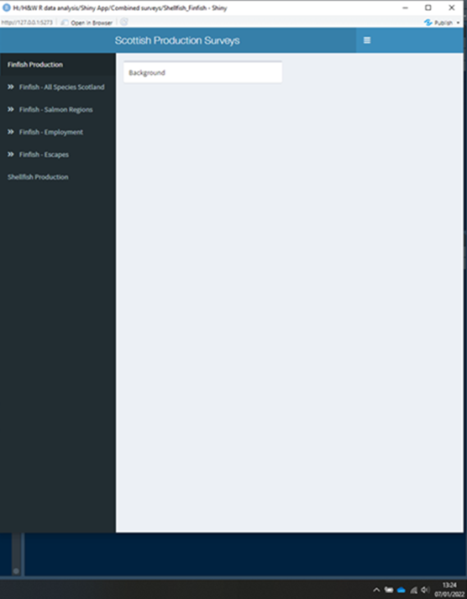
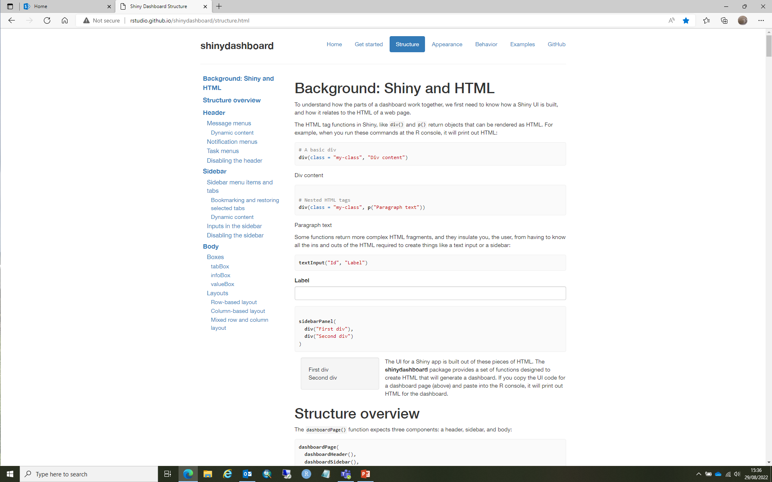
Dashboard Layout
http://rstudio.github.io/shinydashboard/structure.html
Notes:
Once you have all your dropdowns and sliders working you can add your layout design. I found it easier to do it this after getting the reactive aspects working so there was less code to go through if things were not working. Rstudio web pages are useful in planning your layout.
There may be a set layout that your group/department follows, so contact colleagues to check this.
At this point I organised a couple of meetings, one within my group to get my team to test my shiny and give me feedback on how it looked and worked and if they thought anything was missing. The second was an end users workshop with colleagues from Aquaculture Policy the Fish health Inspectorate and other science colleagues- basically anyone I thought might be interested!

Slide 18
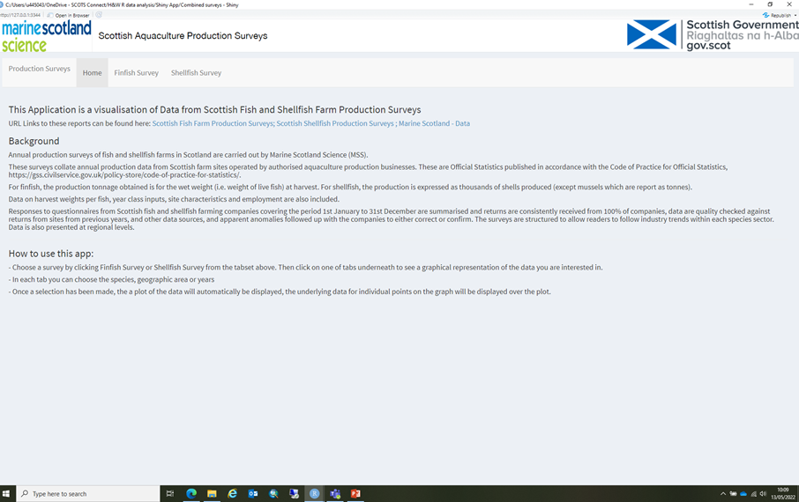
https://scotland.shinyapps.io/sg-aquaculture-production-surveys/
Notes:
Here you can see the front page of the Production Survey shiny. Its palette and layout follow the other Shinys produced by Marine Scotland Science.
The front page gives information about the data and how to use the Shiny. There are links to the Surveys where the tabulated data can be downloaded in a .csv format
Along the tab bar you can access the data from the 2 surveys finfish and shellfish.

Slide 19
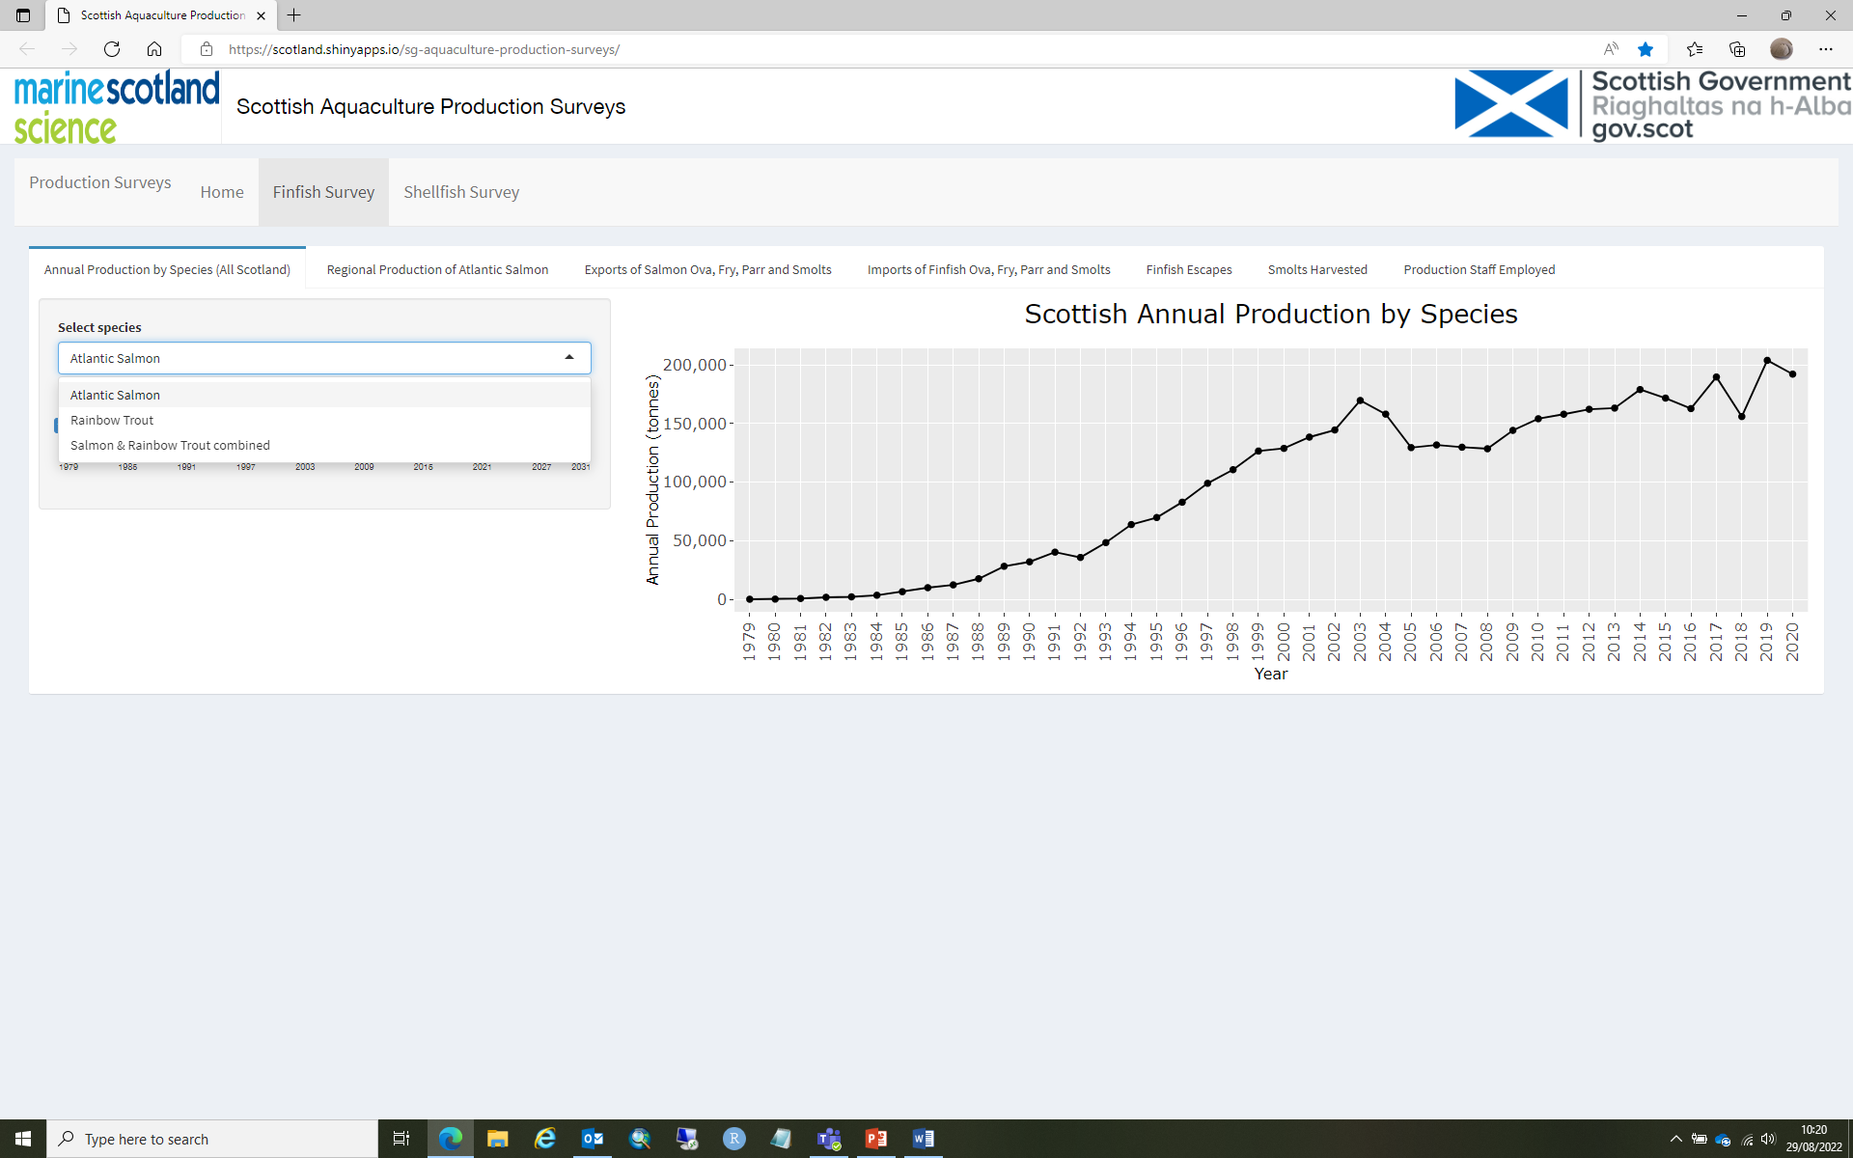
Notes:
After you have selected one of the surveys there is another set of tabs for each section of the survey that colleagues in science and policy felt would be useful.
In each tab there is a dropdown menu for species and/or region and a plot window
You can select the species you are interested in from the dropdown, and the plot will appear accordingly.

Slide 20
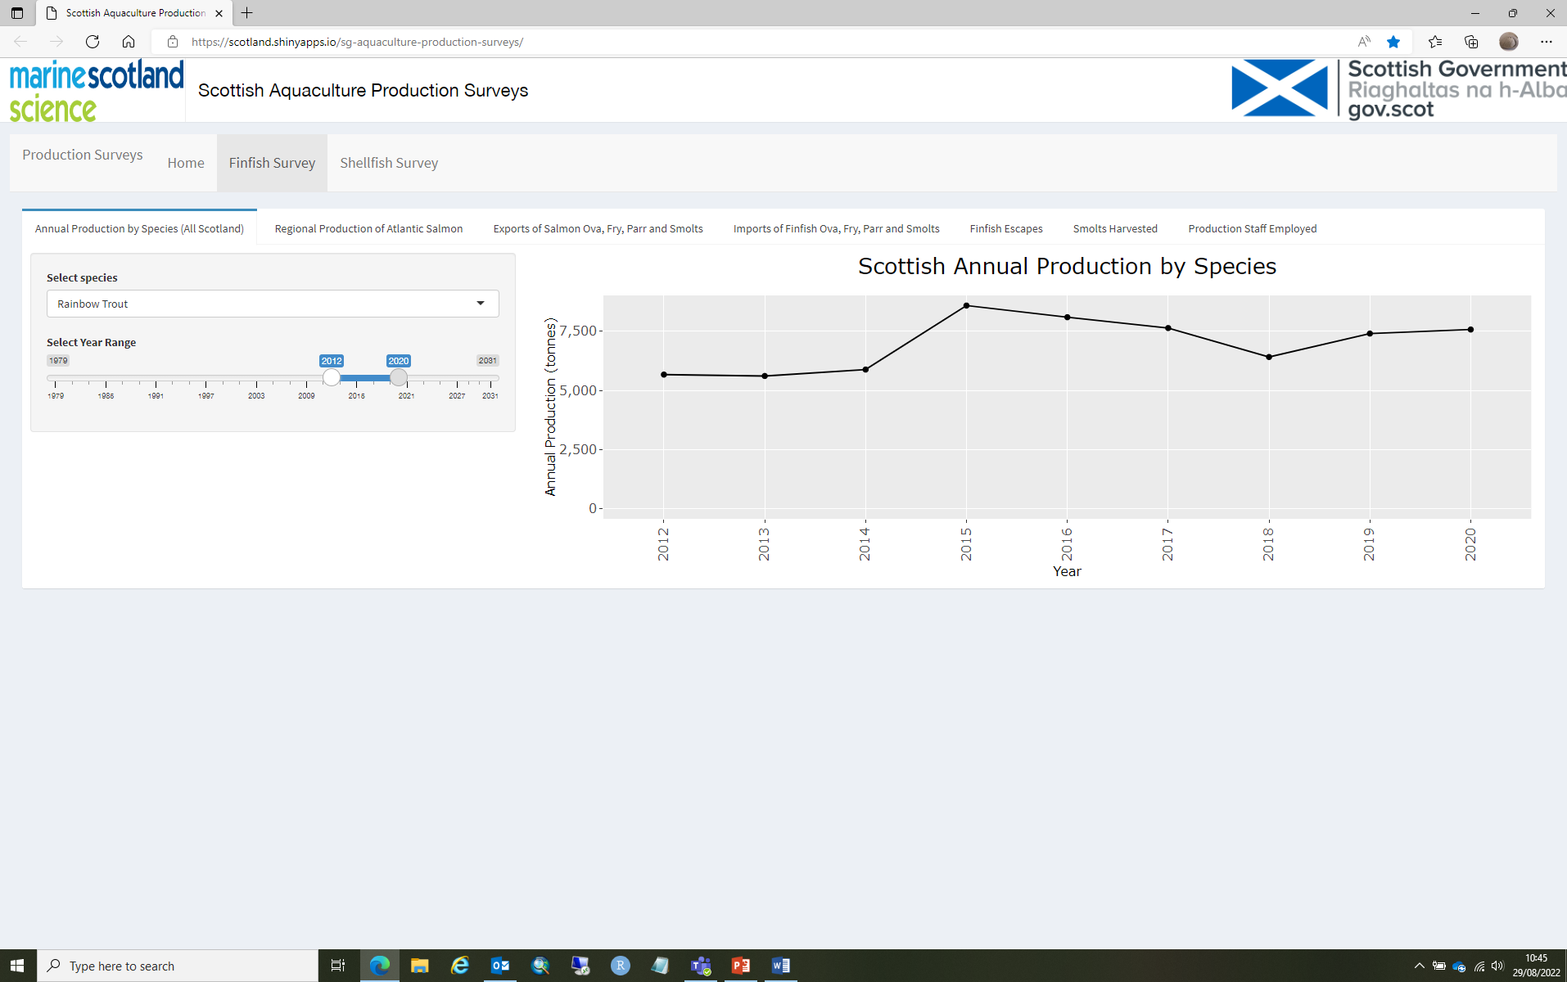
Notes:
The year slider allows you to zoom in on a particular year range

Slide 21
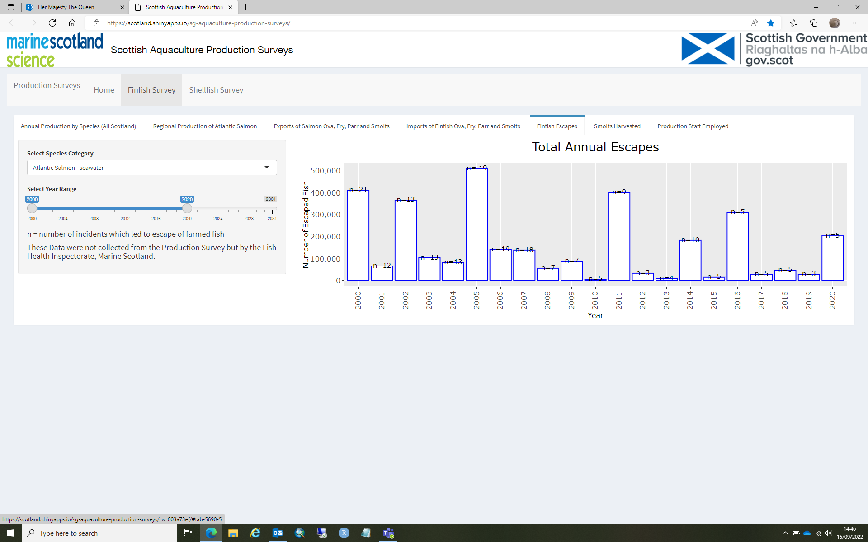
Notes:
Here you can see a Bar plot for the escapes data.

Slide 22

Getting your Shiny online
Make a prototype Shiny and publish on the free server Shiny.oi
Instructions on Saltire
Contact Jay Ware to get Shiny on Scotland.shiny.io
Notes:
Make a prototype Shiny and publish on the free server Shiny.oi
This has time limitations and only 5 people can access it at one time, but it is good for testing.
Once you are happy you and contact Jay Ware in the R Users Team so you can get a Token and Secret to get your Shiny on the Scotland.shiny.io

Slide 23
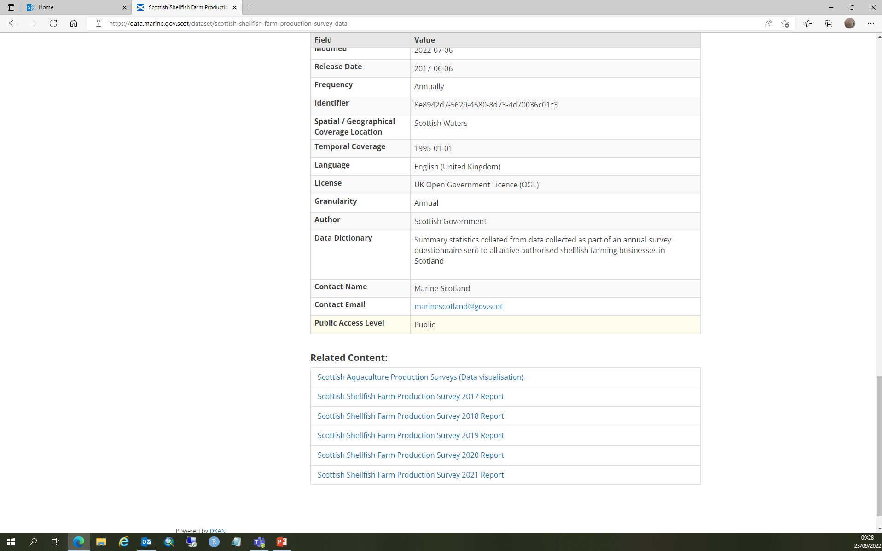
Getting Shiny on Website
We were able to get the link for the Shiny on the Marine Scotland Data Pages –this is not easiest to find at the bottom of the page.
We are in Communication with the Web Team to get the Shiny on the SG website
Notes:
We wanted our Shiny to be accessible internally and externally.
We were able to get our Shiny on the MS Data pages with the data downloads for the Surveys. This is not the most visible location for people to find, so we and are in the process on getting the link on the Production Surveys Collections pages on the main SG pages.

Slide 24
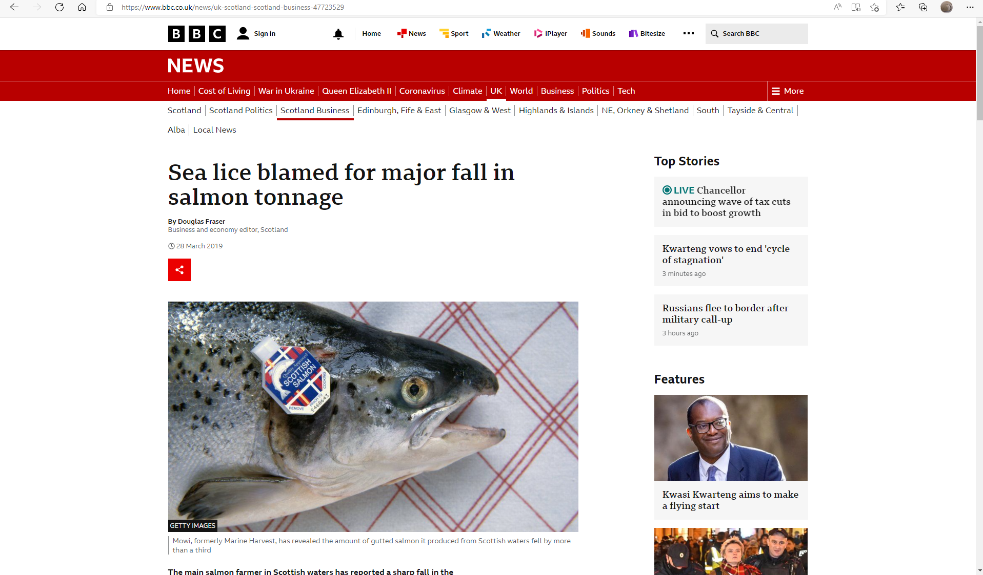
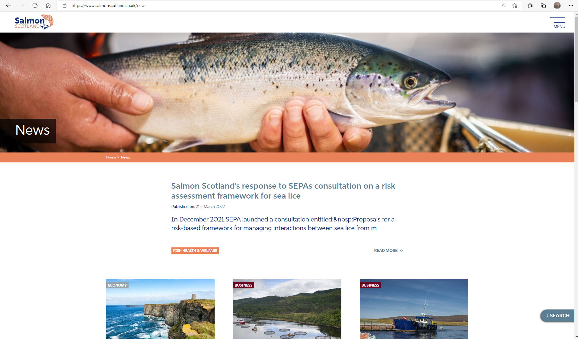
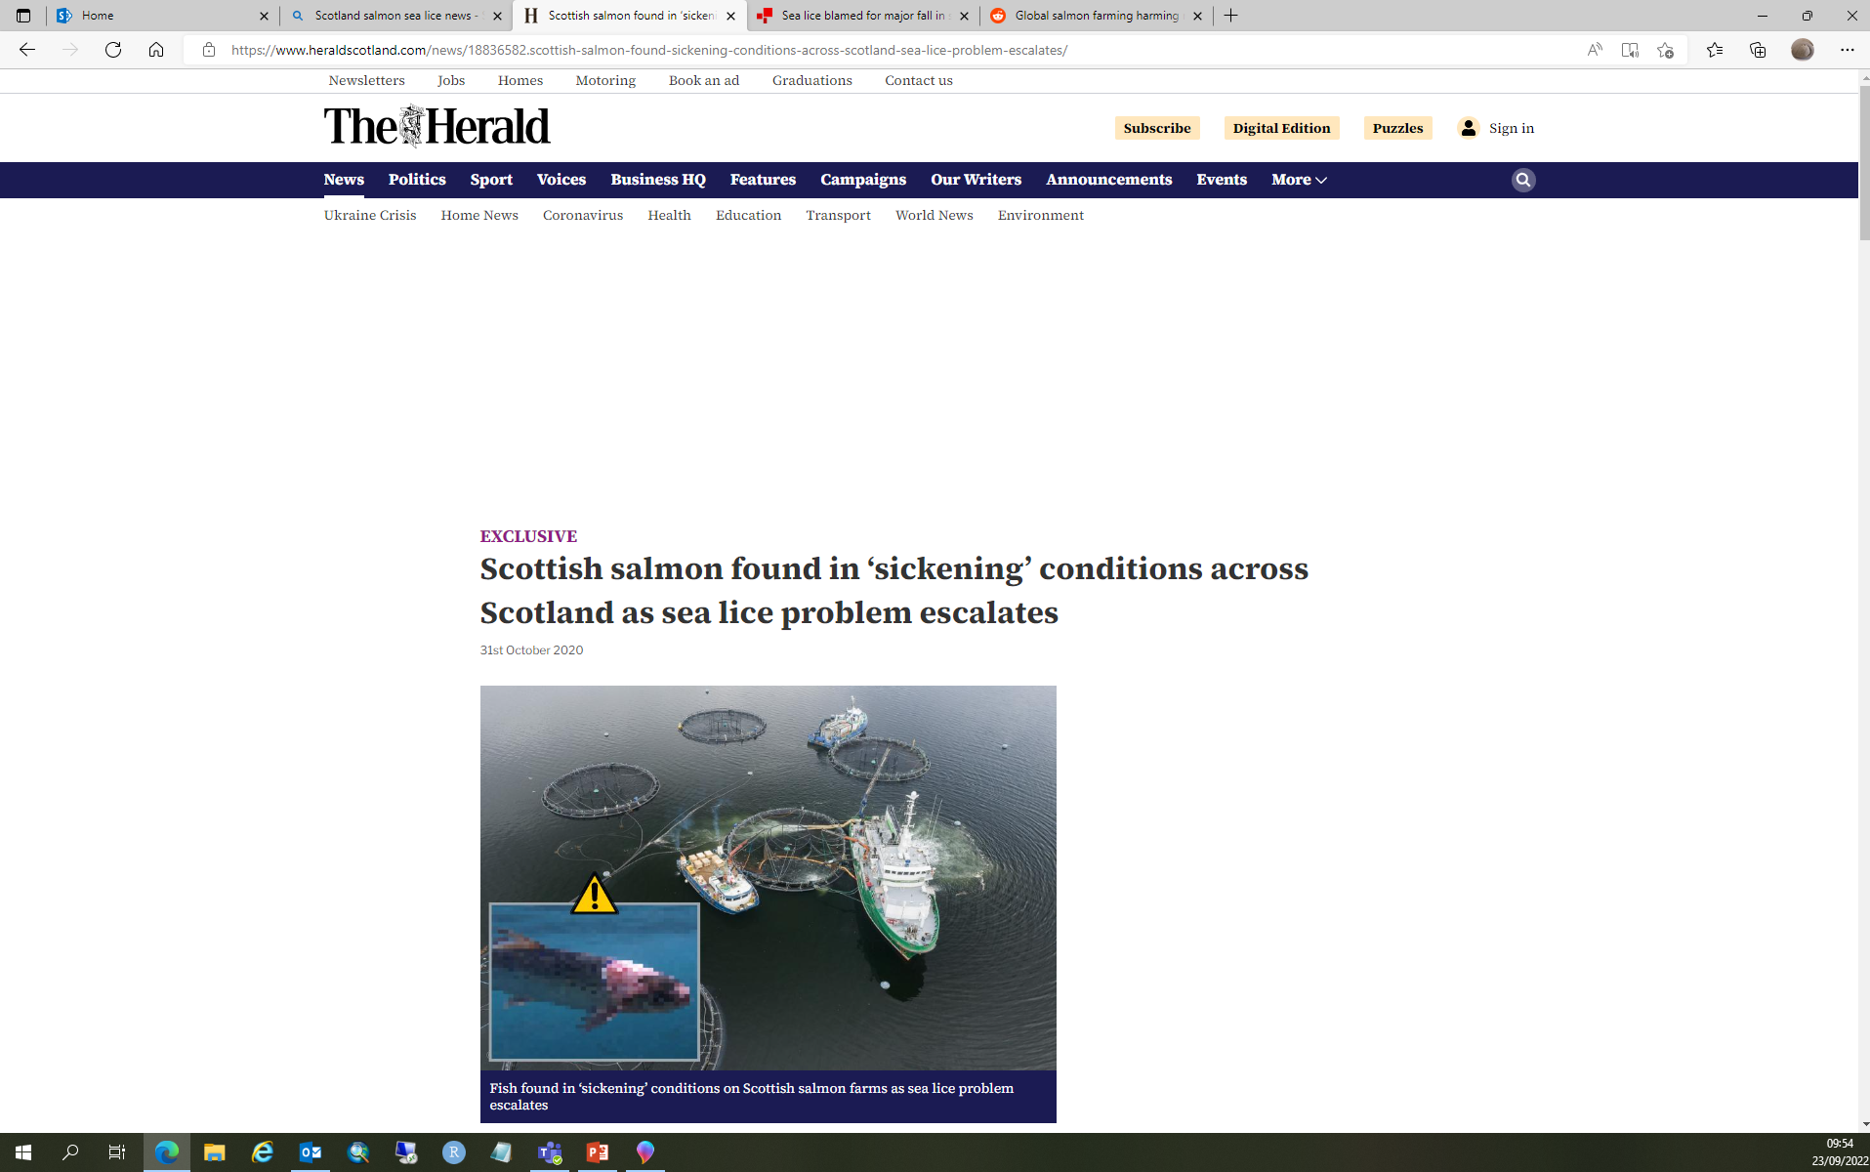
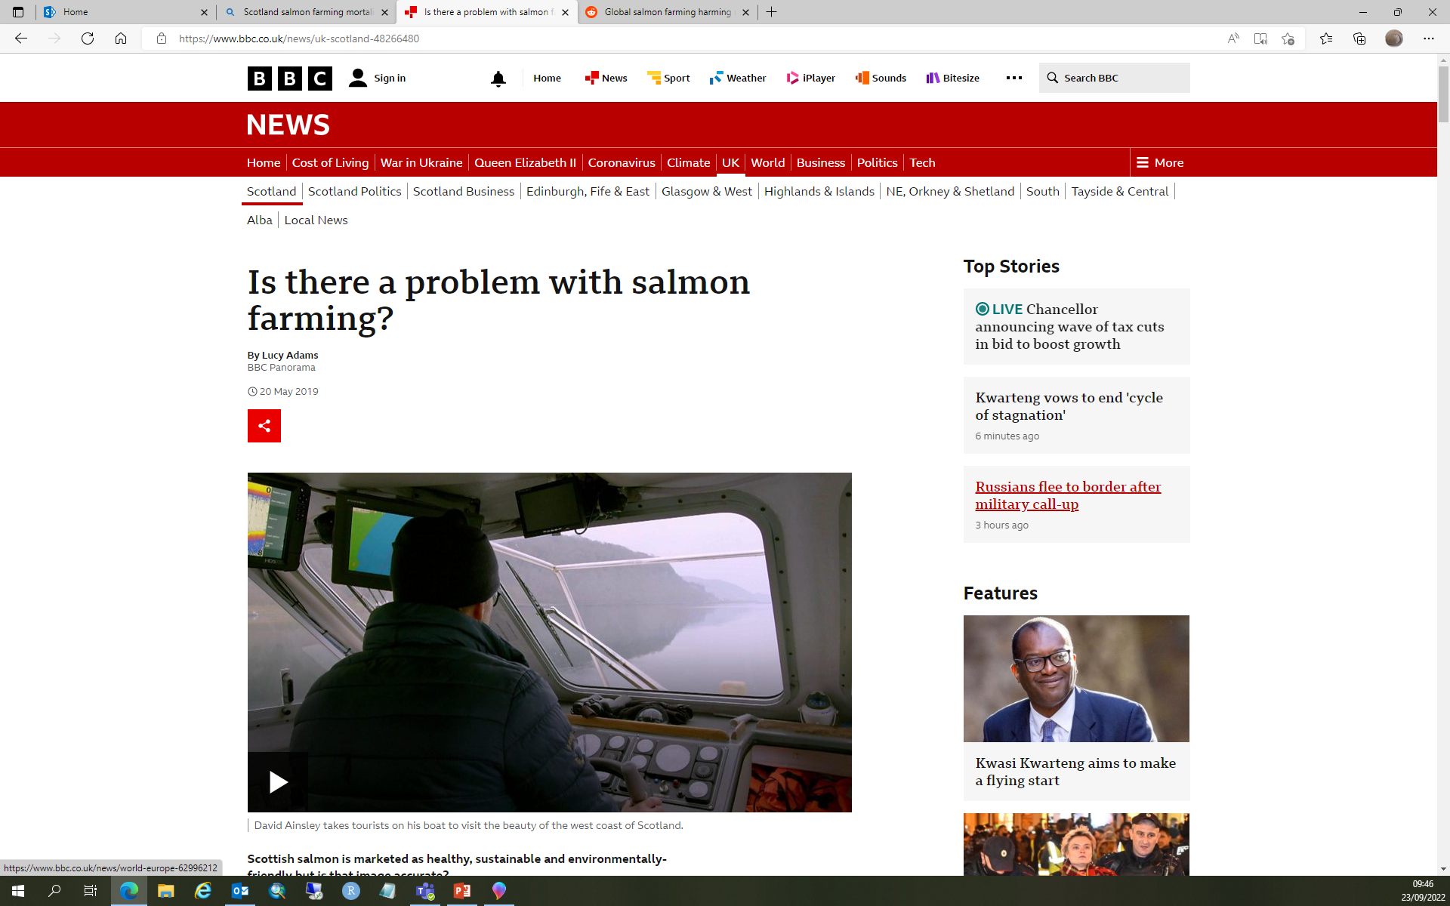
Shiny for Sea lice and Mortality data
Notes:
Following the usefulness of the Production Survey Shiny, my Group leader thought it would be good to make another one for some the other data we work with.
Salmon farming in Scotland can be a highly sensitive issue, with polarised views for and against the industry.
It is important that Marine Scotland is transparent and as open as possible with the data it uses for analysis.

Slide 25
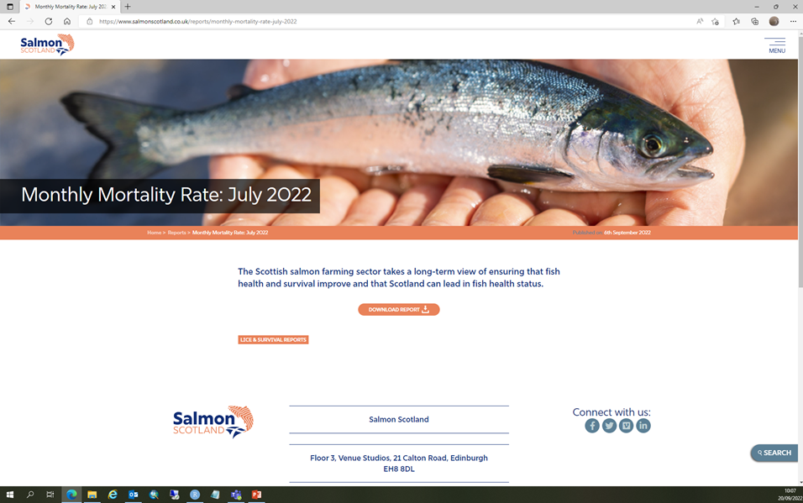
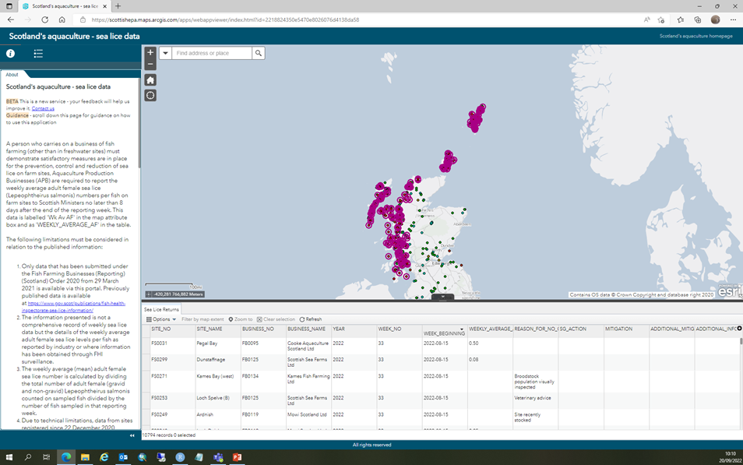
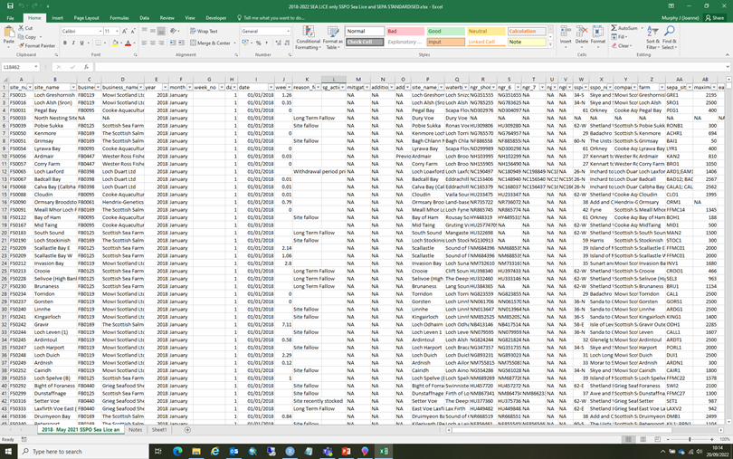
Sea Lice and Mortality Data
Notes:
We collect and collate the monthly data produced by the salmon industry on fish mortality and the sea lice counts published by SEPA and FHI on the Scotland Aquaculture Website. This data is freely available, but the historical data gets removed periodically. Therefore the long term data set we collect is very valuable for analysis and modelling.
However, for accessible up to date information for Science and Policy, it was felt a Shiny readily to hand would be useful for making interpretations of trends.

Slide 26
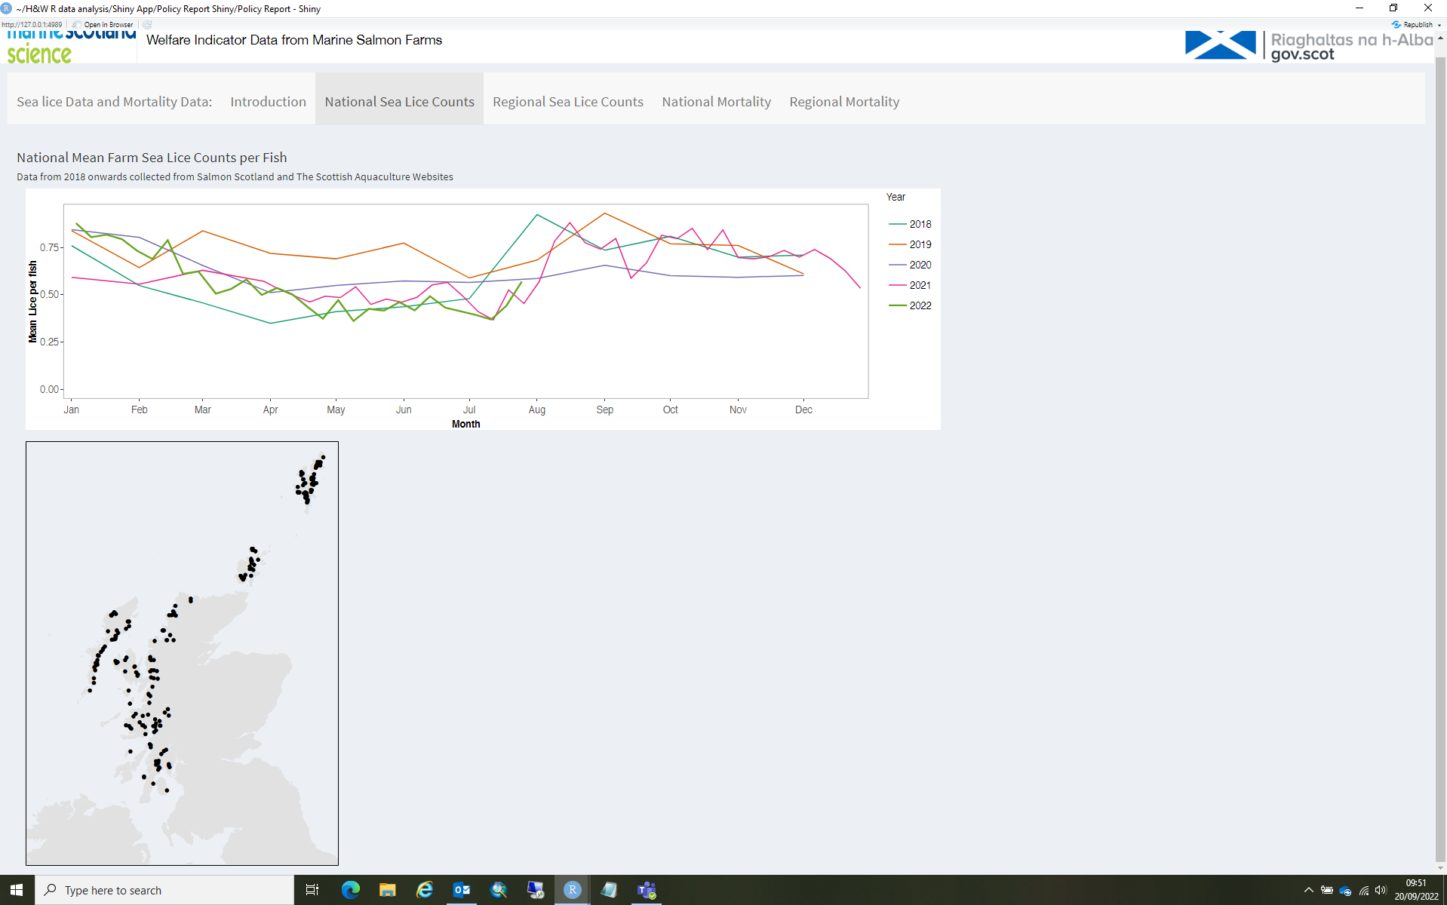
Notes:
So here you can see the prototype for the Welfare indicator Shiny. This is the National sea lice data tab.
I used a similar layout to the Production Survey Shiny, but with a few changes.
For these data, my colleague Stephen Ives had already created functions in R to make the plots for the sea lice counts and the salmon mortality. So I was able to import these into my Shiny directly. It was felt that a map of the fish farm locations would be helpful so I added one we already had quite easily using img() function.
After discussion with science and Policy colleagues, it was decided that dropdowns and sliders were unnecessary for the shiny. This made my life easier as I did not want to unpick Steve’s code in order to make them work.

Slide 27
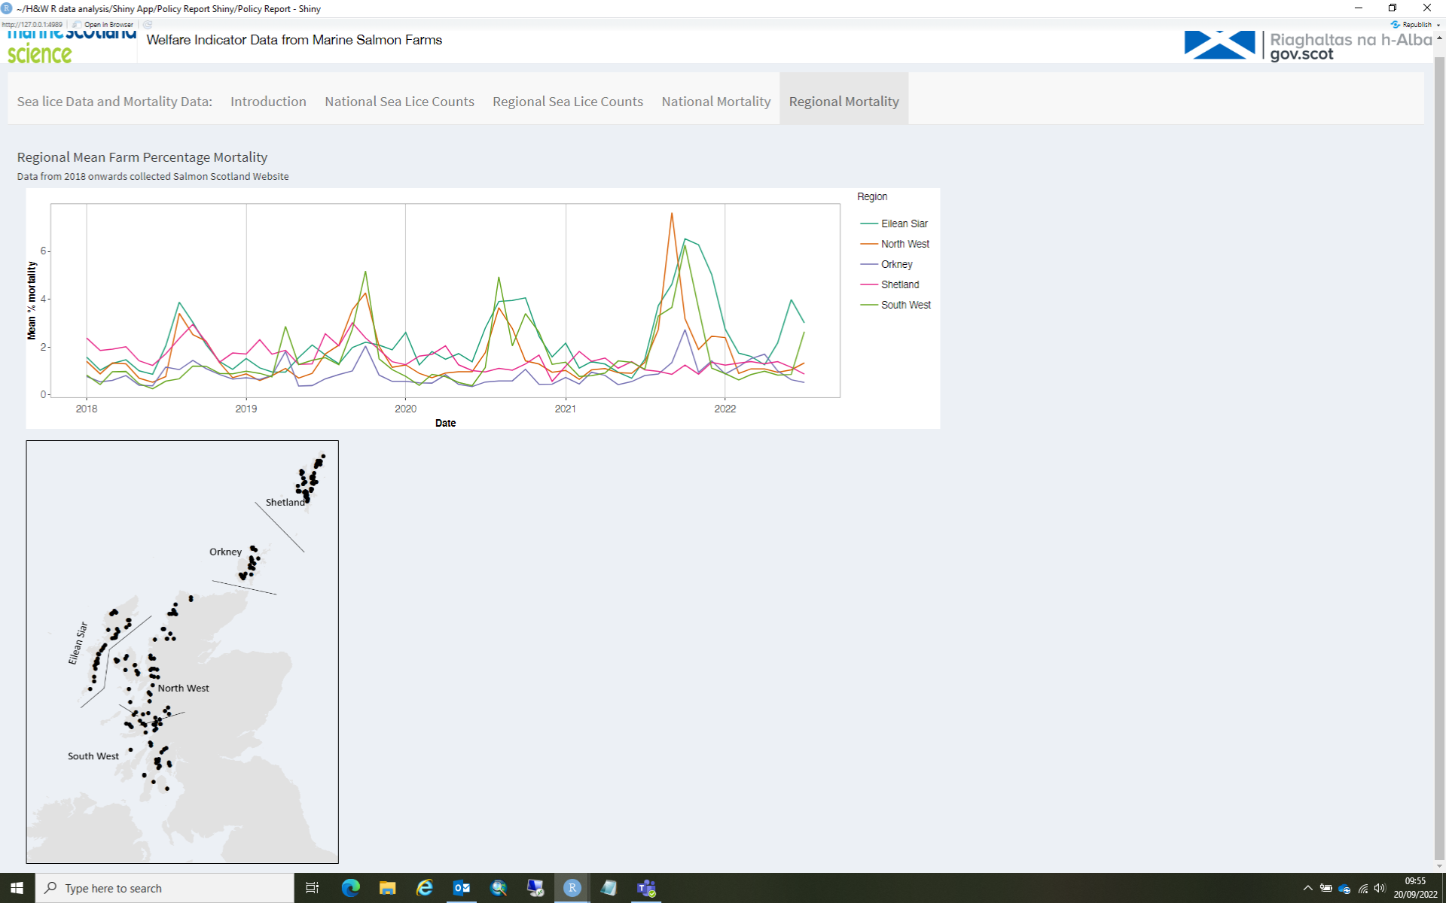
Notes:
Here you an see the data for the regional mortality tab

Slide 28
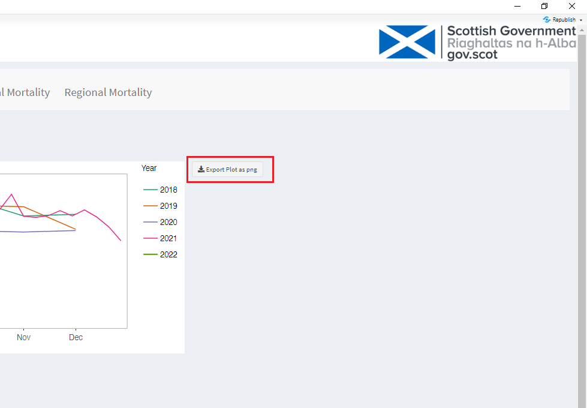
My Next Steps
How to Download Plots and Data
Notes:
After more feedback, it was felt that before the Shiny goes out on a public facing website, it would be useful to be able to download the plots and the plot data. So this is the stage I am at now.
This appeared to be an easy addition, but working on Scots can often be a challenge, so at present I am trying to work out how to do this without R complaining. It seems that the installation of download buttons might need to be done outside the Scots environment.

Slide 29
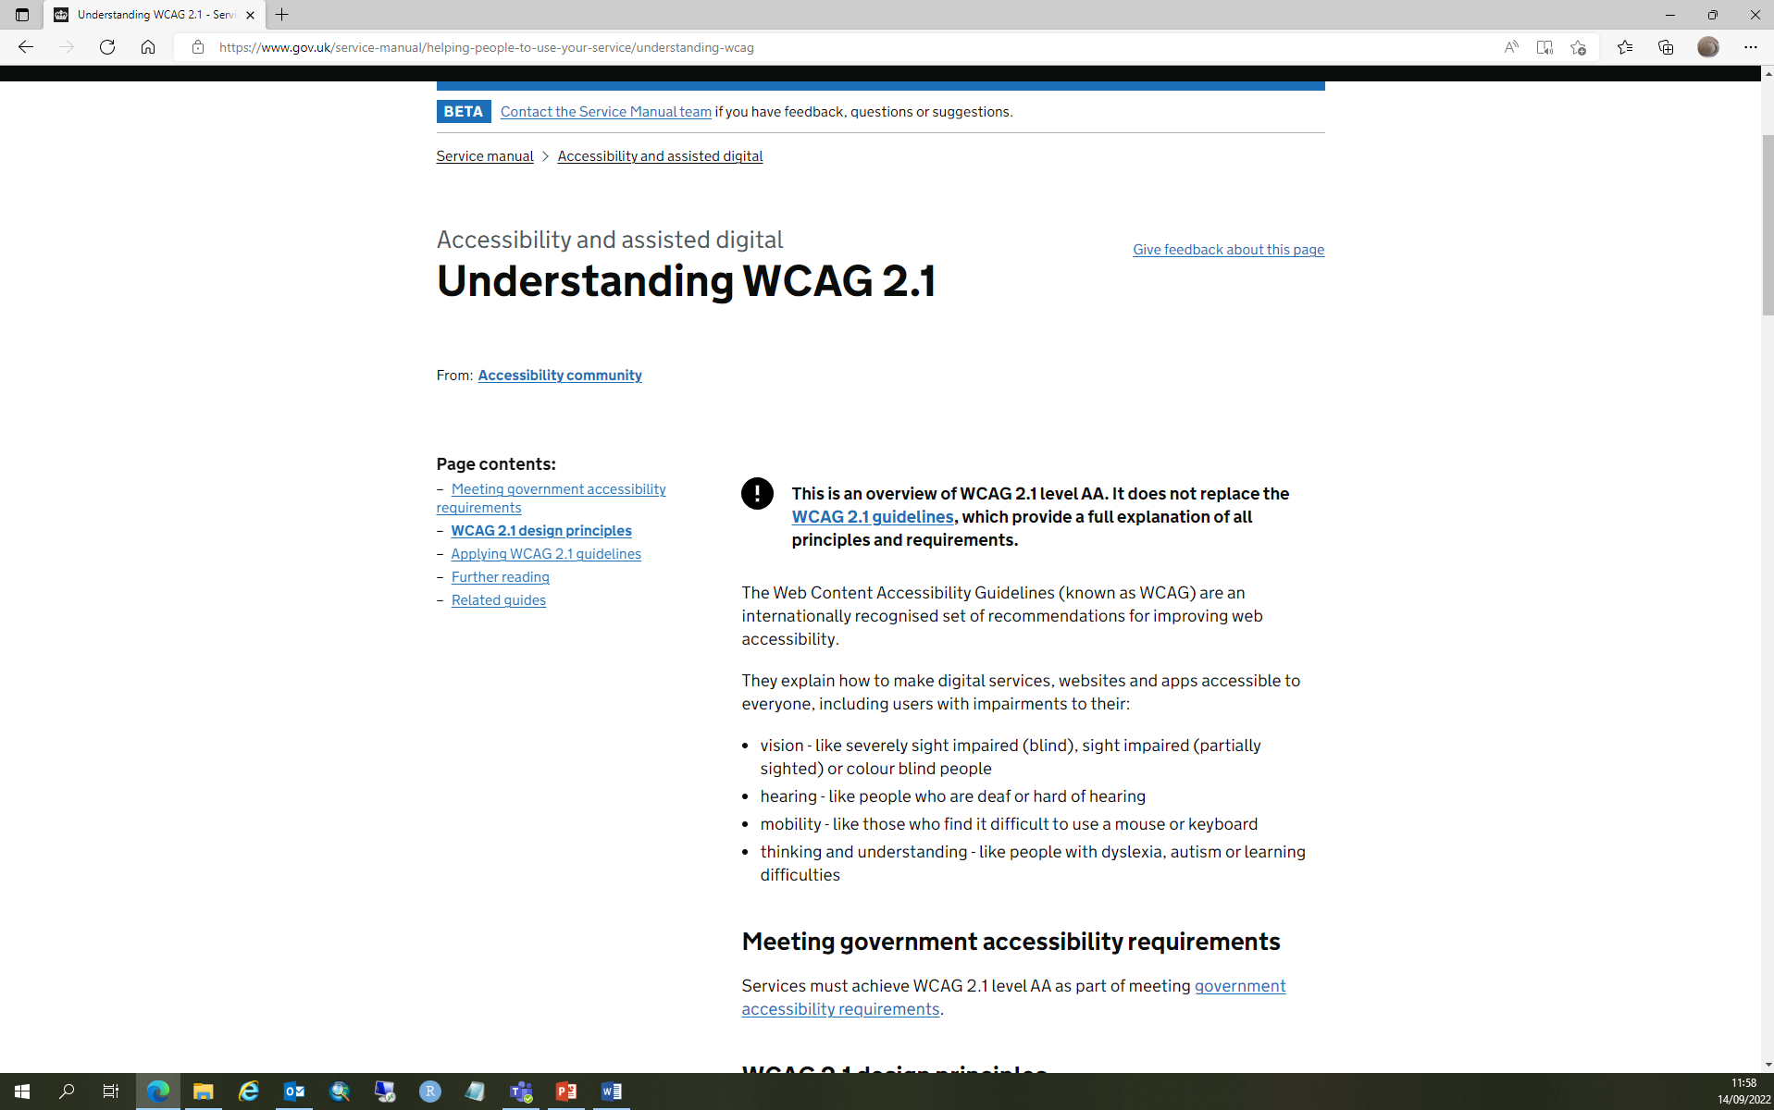
Accessibility
https://www.gov.uk/service-manual/helping-people-to-use-your-service/understanding-wcag
Contact the Accessibility and Usability Team
Email: digital.accessibility@gov.scot
Notes:
Having made the Shinys I considered the aspect of accessibility.
In hindsight it might have been better to address this before starting the Shiny, but, I felt that until I had produced something, it was hard to evaluate its accessibility.
I have sent the Production Survey Shiny to the accessibility team and am waiting for their evaluation. I hope I can use this going forward with further Shinys we produce.

Slide 30


Summary
Shiny Apps can be frustrating to set up, but second one is easier.
Recreational Fisheries and Aquaculture policy colleagues, have found this is an intuitive visualisation of the tabulated data.
Industry Stakeholders, such as Salmon Scotland have requested access to the Shiny.
Notes:
Shiny Apps can be frustrating to set up, if you are quite new to R, but once you have made one the next is one is a piece of cake!
Policy colleagues and Stakeholders have found this Shiny useful as an easy visualisation of the data.
So going forward Shiny Apps will be a valuable tool for increasing data accessibility.

Slide 31
Useful Resources
https://statslectures.com/
https://mastering-shiny.org/index.html
https://shiny.rstudio.com/tutorial/
https://stackoverflow.com
https://style.ons.gov.uk/category/data-visualisation/interactives-chart-animations-dashboards/
http://rstudio.github.io/shinydashboard/structure.html
Building Shiny apps - an interactive tutorial (deanattali.com)
https://scotland.shinyapps.io/sg-aquaculture-production-surveys/
https://www.gov.uk/service-manual/helping-people-to-use-your-service/understanding-wcag
Notes:
Here are some links I found useful.

